Slide 1



Tippecanoe Local Warm-up Card Game 1.0
M

Slide 2

BINGO Q&A
Q1: What is the name of the cafe next to Purdue University?
A1: Greyhouse Coffee & Supply Co.

Slide 3
M
Magnification

Slide 4


M1：Zoom in on the letter A
M1.001
M1.002
M1.003
Draw an apple
Find objects that start with A
Trace the number 1

Slide 5
M1：Zoom in on the letter A
M1.004
M1.005
M1.006
Spot the letter A in a book
Create a story using A words
Color the number 1

Slide 6

M2：Zoom in on the number 1
M2.001
M2.002
M2.003
Draw one apple
Find one object
Trace the number 1

Slide 7

M2：Zoom in on the number 1
M2.004
M2.005
M.006
Color the number 1
Identify one thing you love
Count to one

Slide 8

M3：Zoom in on colors
M3.001
M3.002
M3.003
Draw a red apple
Find something red
Trace the word red

Slide 9
M3：Zoom in on colors
M3.004
M3.005
M3.006
Identify red objects around you
Create a red-themed artwork
Color a red object

Slide 10

M4：Zoom in on actions
Walk
M4.001
M4.002
M4.003
Run
Jump

Slide 11
M4：Zoom in on actions
M4.004
M4.005
M4.006
Wave
Clap
Dance

Slide 12


only the letter sequence 'M'
In just a few minutes, we drafted four subsections of the 'M' part: M1, M2, M3, and M4, each divided into six smaller components. For instance, M1 includes M1.001, M1.002, M1.003, M1.004, M1.005, and M1.006.
How many new card combinations can you create in just a few minutes using only the letter sequence 'M'?

Slide 13
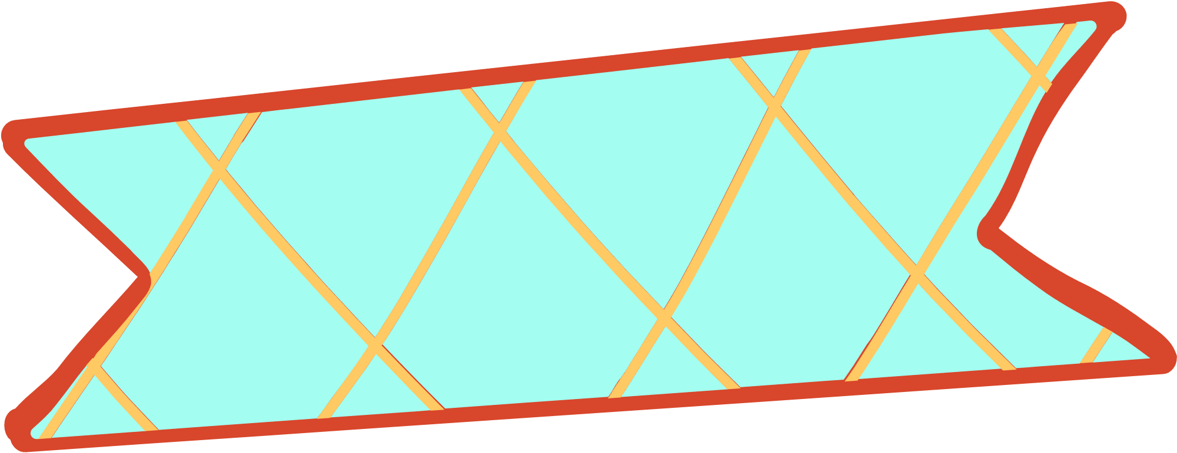

1,296 possible combinations
To calculate the total number of possible combinations when selecting one item from each of four groups (M1, M2, M3, M4) with six items in each group, you would use the following calculation:
?Each group 𝑀M has six options (𝑀.001M.001 to 𝑀.006M.006). When selecting one item from each group, the number of possible combinations 𝐶C is given by multiplying the number of options in each group. Since there are four groups, each with six options, the formula for the total number of combinations 𝐶C is:?𝐶=6×6×6×6C=6×6×6×6?
Let's calculate that:?There are 1,296 possible combinations when selecting one item from each of the four groups (M1, M2, M3, and M4), each having six items.

Slide 14
Craft Your Own Card Set, One Card at a Time

